Slide 1
Generation of synthetic data from real MNO data through Neural Network: motivations, techniques and preliminary results
1st June 2022
5th web meeting of the Task Force on Mobile Network Operator data for official statistics (TF MNO)
Authors: Fabrizio De Fausti – Massimo De Cubellis – Francesco Pugliese – Roberta Radini
Istat | DCME | MEC

Slide 2
OUTLINE
Why use synthetic data
How to generate synthetic data

Slide 3
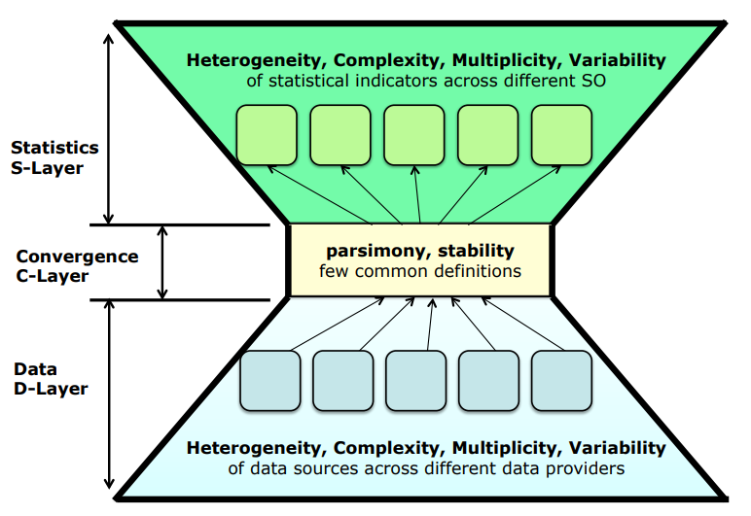

Why use synthetic data
RMF- Reference Methodological Framework for MNO
Statistical Population
A PROXY
Of Statistical Popolation obtained by source data
ESTIMATES
Statistics Layer
constraints, definitions, rules, algorithms, data transformation
Data Layer
data source
3
Notes:
we think it is useful to re-propose, very quickly, some slides from the last presentation, to explain why we thought synthetic data are useful.
In particular at what point in the process do we find this data useful.
In the Reference Methodological Framework for MNO represented by the hourglass shape where we distinguish three different layers: Data Layer, Convergence Layer and Statistics Layer.
In these three levels the raw data are transformed according to specific definitions and algorithms to provide the sufficient information to generate the statistical data (here we named A PROXY Of Statistical Popolation ) these Data will feed: indicators and estimates on the populations of interest.
the processing and transformation algorithms of the raw data are concentrated in the convergence level to build the aggregate data that the MNOs provide to NSI for their statistics.

Slide 4
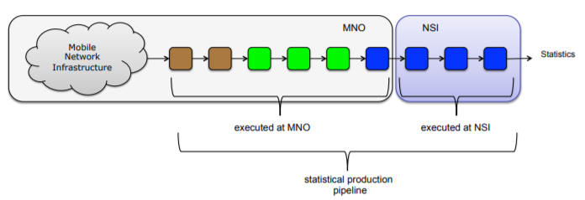

Why use synthetic data
Can synthetic data transform the pipeline in a new way?
Algoritms to define:
Localization;
Statistical concept (e.i: usually resident population )
or parameters (e.i.: what is the timing of night?)
Synthetic
DATA
Open-source by Sinthetic data
reference pseudo-code description
open-source
human-readable guidelines
Notes:
If you remenber The steps of the pipelene are green, blu or brown coloured according to the transparency of the algorithms used to make it.
In particular, the green activities performed on the raw data can be shared with a speudo code, but perhaps even more, developed in collaboration MNO-NSI.
In such a way that the code developed by NSI thanks to synthetic data can then be applied to real data.
In this case the ownership of the algorithms would be of the NSI and could be shared.
The Night Population is population usually staying in a place during the night for a period

Slide 5

How to use synthetic data
MNO
NSI
Execute synthetic data generation algorithms
Define algoritm to tranform MNO data
Code of Algorithms
read
read
MND
Write/send
Synthetic data
Execute Code

Slide 6
How to generate synthetic data
Statistical models, such as Bayesian networks, or Hidden Markov models, provide an explicit, parametric model of real data distribution. The features these models extract from their training data is determined upfront.
Non-parametric models, such as generative adversarial networks (GANs) or variational auto encoders (VAEs), do not estimate a parametric likelihood function to generate new samples from a representation of the joint multivariate distribution of real data.
We focused on:
the development of CTGAN via a Framework called SDGym (Synthetic Data Gym)
and the evaluation of Utility metrics and Privacy metrics
Always keeping in mind use and nature of these senthetic data which:
must represent the characteristics of real data (SIM code, antenna/sector code and Time)
do not need to be necessarily extended in space and time as they will be used to develop algorithms in house of NSI

Slide 7
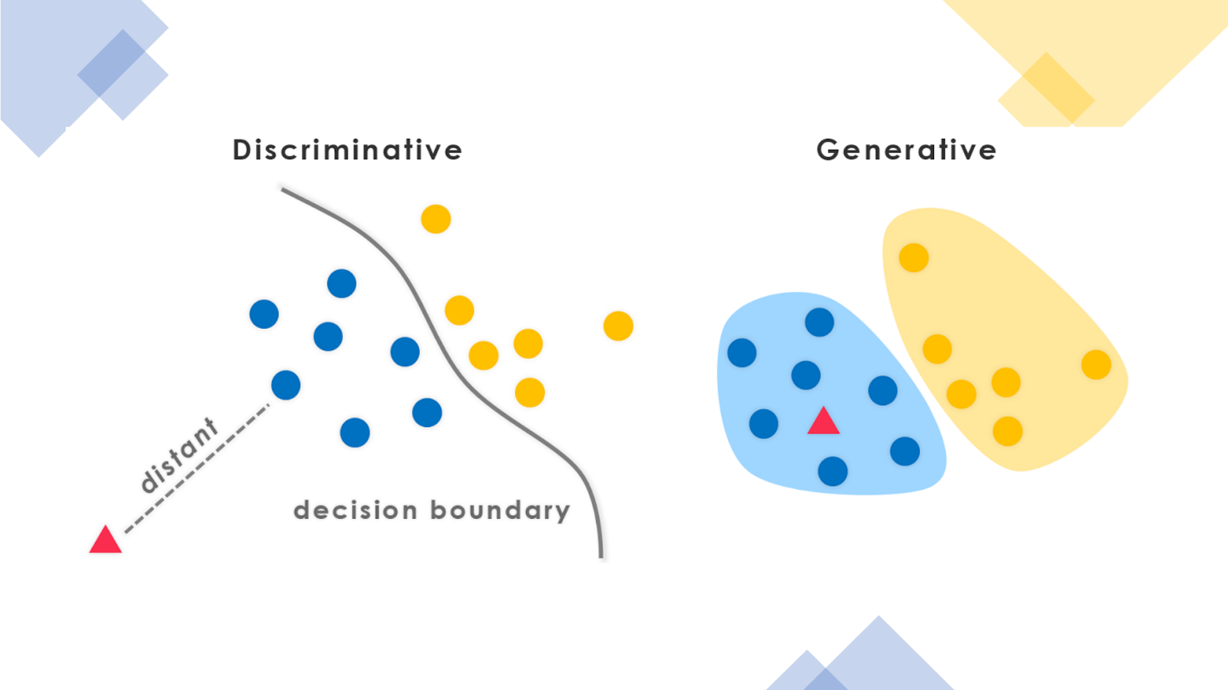
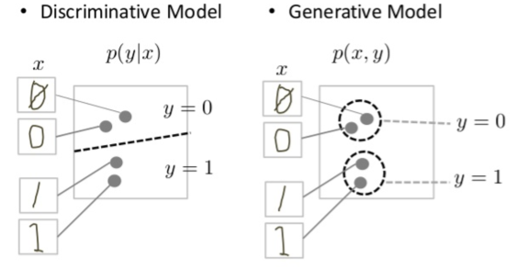
Generative Modeling
Generative Modeling is an Unsupervised Learning Task leading to the automatic discovering of regularities or «patterns» within the Original Data in order to generate new Synthetic Data.
Therefore, a Generative Model can be used to generate new data samples, which could teorethically belong to the Original Dataset, even though they are new synthetic data.

Slide 8
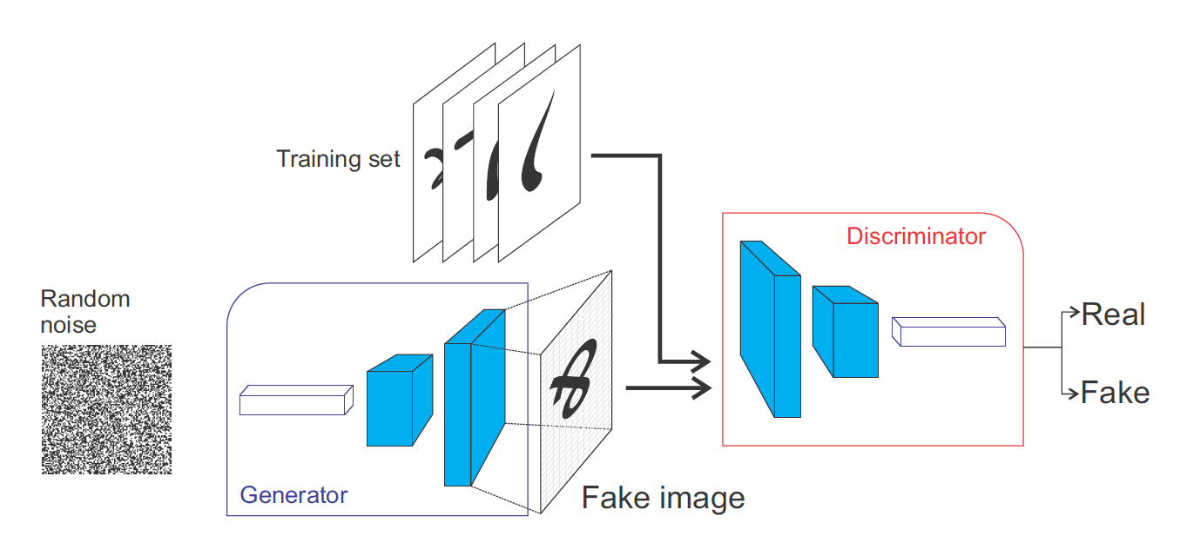
Generative Adversarial Networks (GAN)
A Generative Model is a statistical model of the joint distribution P(X,Y) over a given observable variable X and a variable Y
Generative Adversarial Networks (GANs) were introduced by the Guru of Deep Learning, Ian Goodfellow in 2014 and are a way to learn Latent Spaces of Images. A Latent space is a simple hidden representation of a data point. The generator model in the GAN architecture takes a point from the latent space as input and generates a new image. Through training, the generator learns to map points into the latent space with specific output images and this mapping will be different each time the model is trained.

Slide 9
Generative Adversarial Networks (GAN)
Basically, a GAN is made of a "Fake" Network (Generator) and an "Expert" Network (Discriminator) which are adversarially trained to overcome the other one reciprocally.
GAN Algorithm:
for every epoch:
Extract random points from the Latent Space.
2) Generate images for the Generator adopting random noise (Gaussian Noise better).
3) Mix true images with generated ones.
4) Train the discriminator by these mixed images, with the labels: true for real images, and false for generated images.
5) Extract new points from the latent space.
6) Train the GAN adopting these random vectors, with all labels saying "true". This update Generators weights (only generator, discriminator is freezed) to check if the discrimator is able to recognize them or it says they are all "true" also the generated ones. This trains the generator to mislead the discriminator.
Generator: takes a random vector in input (a random point in the latent space) and decode it into a synthetic image. Once it is trained, the Generator generates new samples shaping new data over the input data distribution in a totally unsupervised way.
Discriminator (or adversarial) : takes a real image or synthetic as input and classifies it as real or fake. In other words the Discriminator is a classifier trying to understand which samples come from the training set and which one are generated synthetic data.

Slide 10
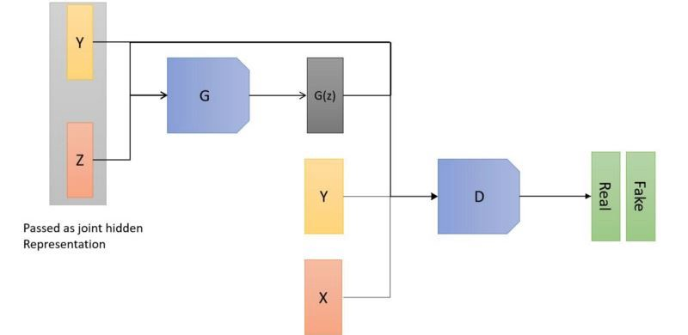
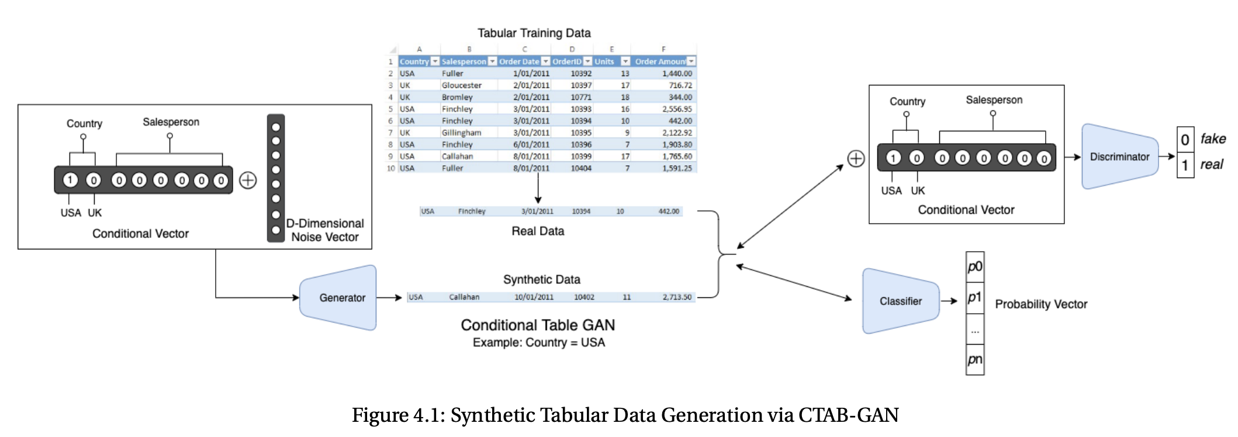
Conditional Tabular GAN (CTGAN)
SDGym’s CTGANs are a combination of Conditional and Tabular GANs.
Conditional GAN: Although GANs are able to generate some good samples of data points, they are not able to generate data points with the target labels (i.e. categorical targets) and if generated these data lack diversity. Conditional GAN was proposed by M. Mirza in late 2014. He modified the architecture by adding the label y as a parameter to the input of the generator and try to generate the corresponding data point. It also adds labels to the discriminator input to distinguish real data better. In this architecture, the random input noise Z is combined with the label Y in the joint hidden representation.
Tabular GAN: These are a class of GANs able to generate tabular data such as: with various data types (int, decimals, categories, time, text) and with different shapes of distribution.

Slide 11
The experimentation (1/2)
Dataset
A random sample of WIND's CDR
Dimension: 10,000 rows – 4 attributes
Attributes: SIM Code Call Date Time call Cell_Call_Code (Sector/Antenna code)
Pre-proceesing (steps)
Pseudo-anonymization
Setting of data-type: categorical (SIM code, Antenna code) or continuous(date and time of call)

Slide 12
The experimentation (2/2)
Process
Input : a random sample of WIND's CDR (original dataset)
Type of process: generate synthetic data
Framework used: SDGym - Synthetic Data Gym Metrics Evaluation ( https://github.com/sdv-dev/SDGym )
Algorithm used to generate synthetic data: Synthetic Data Vault (SDV) – based on CTGAN
Output: synthetic dataset of WIND's CDR (synthetic dataset)
Original Data
Synthetic Data
SDGym - SDV - CTGAN

Slide 13
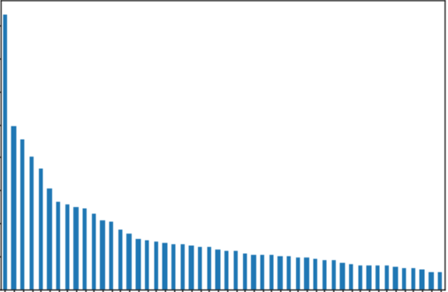
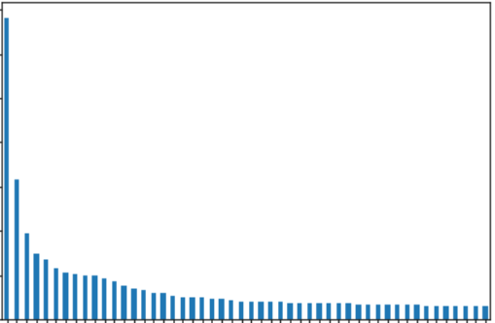
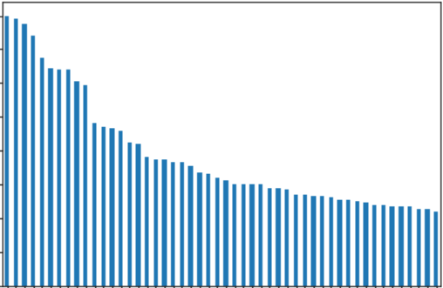
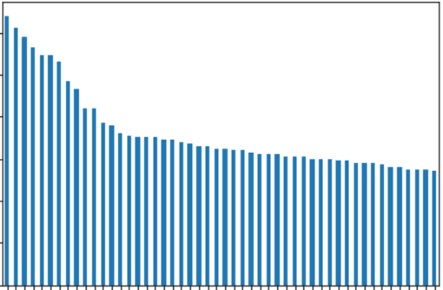
Original and Synthetic Data Univariate Distribution Visualization
Graphical analysis with Univariate Distributions Comparisons on the Categorical Variables from Real Data and Synthetic Data.
 | ORIGINAL DATASET | SYNTHETIC DATASET
SIM_CODE
ANTENNA_CODE

Slide 14
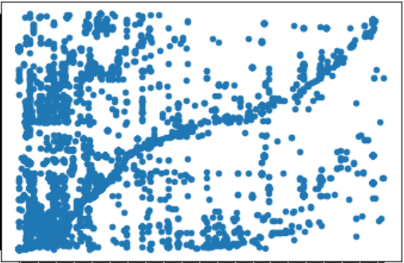
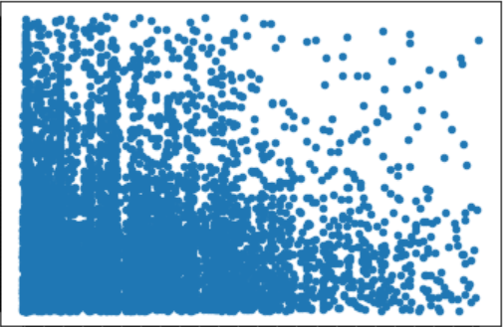
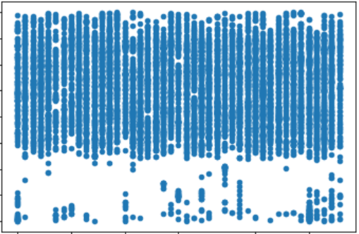
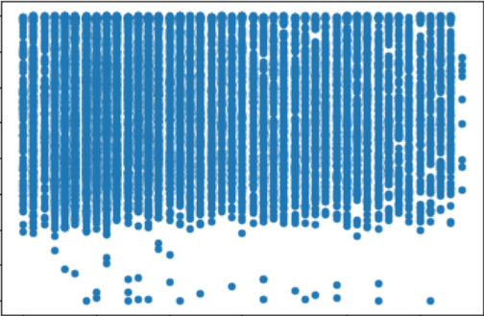
Original and Synthetic Data Bivariate Distribution Visualization
Graphical analysis via Scatterplots of Univariate Distributions Comparisons on the Categorical Variables from Real Data and Synthetic Data.
 | ORIGINAL DATASET | SYNTHETIC DATASET
SIM_CODE – ANTENNA_CODE
CALL_DATA – TIME_CALL

Slide 15
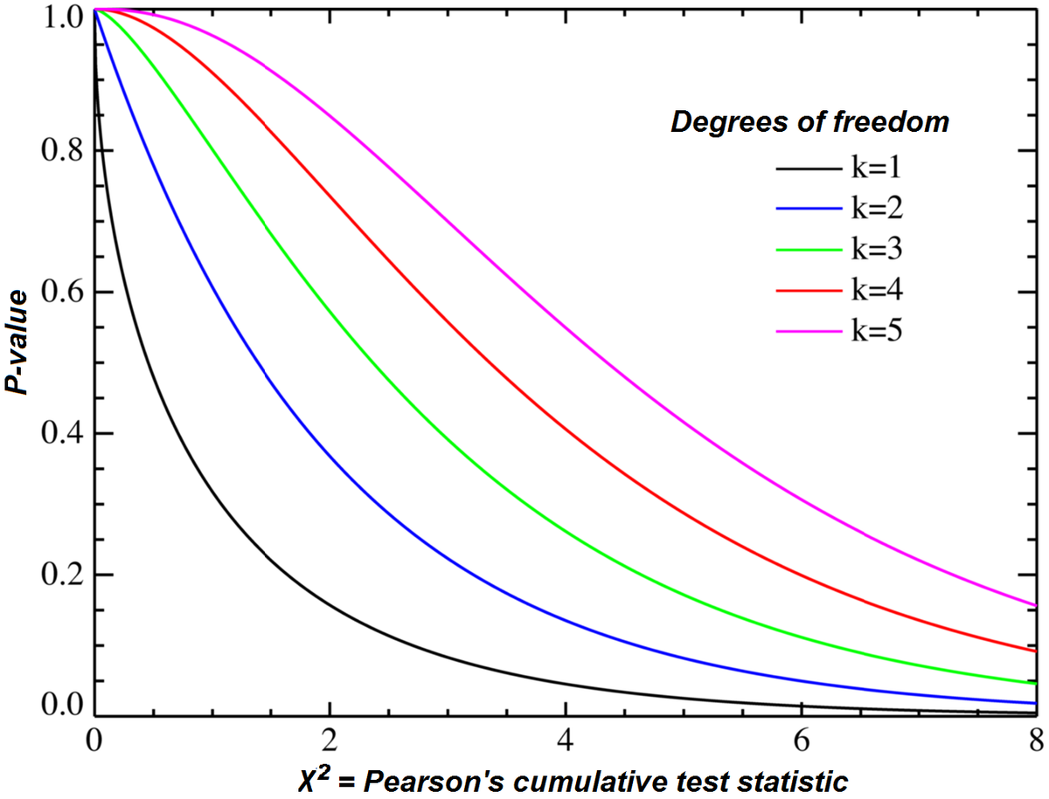
Utility Metrics - Model Evaluation via SDGym Tools: Statistical Metrics
The metrics of the Synthetic Data Gym of the Statistical Metrics Family compare the tables by running different types of statistical tests on them. In the simplest scenario, these metrics compare individual columns from the real table with the corresponding column from the synthetic table.
sdv.metrics.tabular.CSTest: This metric make use of the Chi-Squared Test to compare the distributions of two discrete columns. The output for each column is the CSTest p-value, which indicates the probability of the two columns having been sampled from the same distribution.
Chi-Squared Test p-value must be between 0 and 1. Since we achieved 1.0 in this test, it means that our distributions (original and synthetic) are sampled from the same distribution of data.

Slide 16
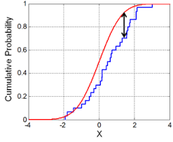
Utility Metrics - Model Evaluation via SDGym Tools: Statistical Metrics
sdv.metrics.tabular.KSTest: This metric uses the two-sample Kolmogorov–Smirnov Test to compare the distributions of continuous columns using the empirical CDF (Cumulative Distibution Function: P(X≤x)). The output of KSTest for each column is 1 minus the KS Test D statistic, which indicates the maximum distance between the expected CDF and the observed CDF values.
The letter "D" stands for "distance." Geometrically, D measures the maximum vertical distance between the empirical cumulative distribution function (ECDF) of the sample and the cumulative distribution function (CDF) of the reference distribution.
If the two samples were randomly sampled from identical populations, what is the probability that the two cumulative frequency distributions would be as far apart as observed? More precisely, what is the chance that the value of the Komogorov-Smirnov D statistic would be as large or larger than observed? If the P value is small, conclude that the two groups were sampled from populations with different distributions. The populations may differ in median, variability or the shape of the distribution.
So our result 0.95375 which is 1-D, means that the distance between CDF of original data and CDF of Synthetic Data is low, hence the two distribution are very close.

Slide 17
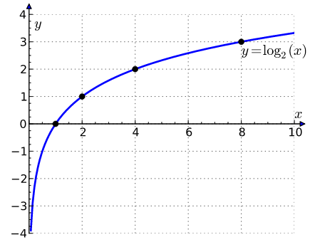
Utility Metrics - Model Evaluation via SDGym Tools: Likelihood Metrics
The metrics of this family compare the tables by fitting the real data to a probabilistic model and afterwards compute the likelihood of the synthetic data belonging to the learned distribution.
sdv.metrics.tabular.BNLikelihood: This metric fits a Bayesian Network to the real data and then evaluates the average likelihood of the rows from the synthetic data on it.
Bayesian Networks Likelihood is the Error calculated on Synthetic data after fitting the model on Real Data. Very low error (likelihood) like 0.00013183 means the two datasets are very close in terms of probabilistic models.
sdv.metrics.tabular.BNLikelihood: This metric fits a Bayesian Network to the real data and then evaluates the average likelihood of the rows from the synthetic data on it. With very low error (close to 0) according to the Log function, the output value must be negative, therefore a score like this one: -17.415473543655498, it is a very good result.

Slide 18
Privacy Metrics - Model Evaluation by Matching Common Values
Privacy Metric: In this kind of metric we merge the Original Dataset and the Synthetic Dataset doing and Inner Join over 1 or 2 columns. And we get the list of rows merged. After this step, we search for all the matches between the Original Dataset and the Synthetic Dataset over 1 other column. These matches will be depicted on a bar plot via histogram. The idea behind this Privacy Metric is looking for “values” within the Synthetic Dataset which are also within the Original Dataset. If there are many of these values, this means that the GAN model is not able to generate a Synthetic Dataset similar to the Original one, but preserving all the values within the Original Dataset, and so preserving its privacy.
We performed 2 Privacy Metrics Tests: In the Privacy Metrics Test 1 we took the field ANTENNA_CODE as first field for the merge and SIM_COSE as second feature for the final match. Viceversa, in the Privacy Metrics Test 2 we chose SIM_COSE as first field and ANTENNA_CODE as second field.
Aggregated Privacy Metric (APM): Eventually, in order to have a final aggregate measure of privacy (APM) in the interval [0, 1] we calculated a normalized sum of all matches. More matches means less privacy, if 1 - (normalized sum) is equal to 1 means high privacy, 0 means low privacy. In our first test we achieved a value close to 0.9876543209876543, which means very high privacy. In the second test we achieved 1.0 as aggregated value which means maximum privacy. The formula we adopted is reported in the next slide with all the results.

Slide 19
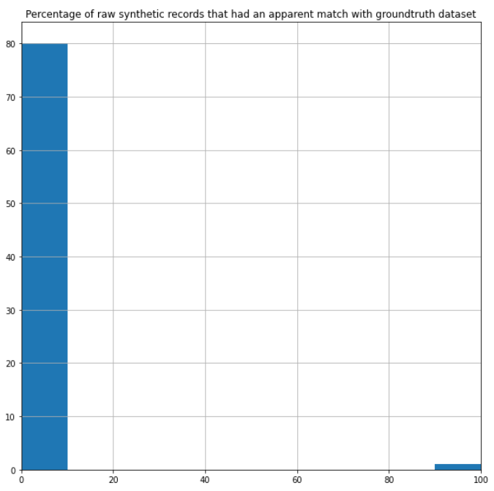
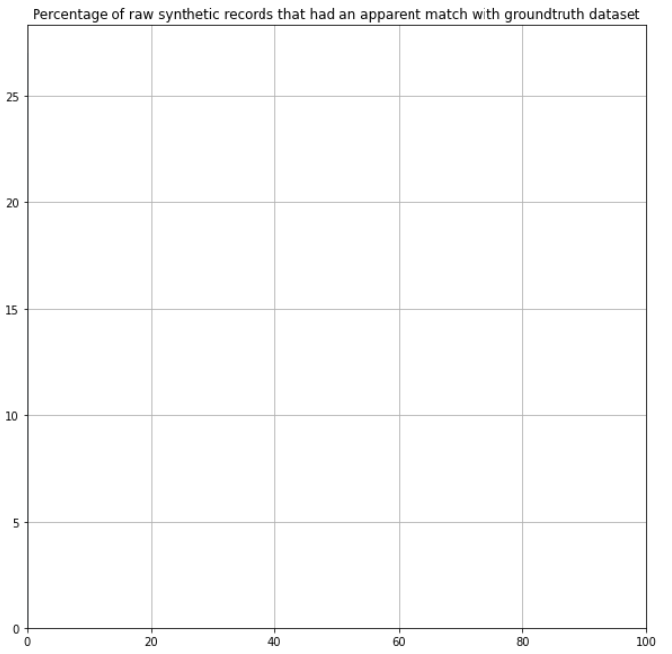
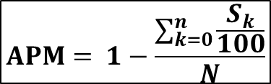
Privacy Metrics - Model Evaluation by Matching Common Values
$$APM= 1−\frac{\sum_{k=0}^{n}{\frac{S_{k}}{100}}}{N}$$
The First Chart (Test 1) means that within the 81 rows obtained with the merge on ANTENNA_CODE there are 80 with 0% of matches on SIM_CODE and 1 with 100% of matches. So there is a small failure in the Privacy Preserving Process.
In the second chart there are no matches and failures.
Privacy Metrics Test 1
Aggregate Data: 0.9876543209876543
Privacy Metrics Test 2
Aggregate Data: 1.0

Slide 20
Considerations and Future Directions
This work displays how to adopt a robust and flexible Deep Learning Framework

Slide 21
References
Goodfellow, I., Pouget-Abadie, J., Mirza, M., Xu, B., Warde-Farley, D., Ozair, S., ... & Bengio, Y. (2014). Generative adversarial nets. Advances in neural information processing systems, 27.
Mirza, M., & Osindero, S. (2014). Conditional generative adversarial nets. arXiv preprint arXiv:1411.1784.
Kunar, A. (2021). Effective and Privacy preserving Tabular Data Synthesizing. arXiv preprint arXiv:2108.10064.
Synthetic Data Gym Link: https://github.com/sdv-dev/SDGym
Colab Jupyther Notebook - Python Code Links of this Work:
Training Colab: https://colab.research.google.com/drive/1v7UkWXnC_4qToHMB6QQWebUFTHJT6Qe4?usp=sharing
Inference and Metrics Evaluation Colab:
https://colab.research.google.com/drive/1FFX4ezYjwUbKiXGrqSuVV0iOr2wBakHa?usp=sharing

Slide 22
Thank You for your attention
FABRIZIO DE FAUSTI | defausti@istat.it
MASSIMO DE CUBELLIS | decubell@istat.it
FRANCESCO PUGLIESE | francesco.pugliese@istat.it
ROBERTA RADINI | radini@istat.it

